Slide 1

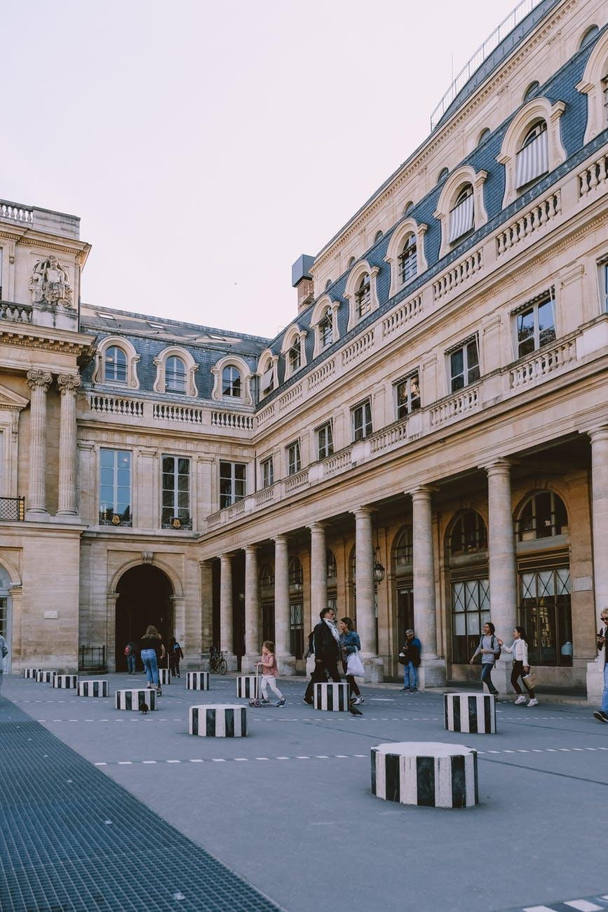
Talking Math
Day 1
Launch
What math questions could you ask about this picture?
Grade K | What shapes do you see? Complete the sentence: _______ is taller than _______. Use blocks to make the building.
Notes:
Link to the Picture

Slide 2
Talking Math
Day 1
Grade K | What shapes do you see? (K.G.A.2) Complete this sentence: _______ is taller than _________. (K.MD.A.2) Use blocks to make the building. (K.G.B.5)
Grade 1 | Where do you see triangles in the picture? (1.G.A.1) What shapes in the picture could you put together to make a different shape? (1.G.A.2)
Grade 2 | Where do you see rows and columns of windows in the picture? Describe how you see them. (2.G.A.2)
Grade 3 | Describe how you might find the area and perimeter of the courtyard. (3.MD.C.6)
Grade 4 | Where do you see parallel or perpendicular segments in the picture? Where do you see symmetry? (4.G.A)
Grade 5 | Estimate the height of one column in meters. What is that height in centimeters? What is that height in kilometers? (5.MD.A.1)
Notes:
After the image:
Find somewhere around you that relates to the math you saw in the image. Take a picture or shoot a video. Send it our way!
Draw your own picture of a palace with some of the same shapes and objects in the picture.
Find collections of objects to count. Describe how you counted them to someone.
Read along: Dinner at the Panda Palace - Where do you see math in the story?
To learn more about the palace in the picture, you can check it out here.
Link to the Picture

Slide 3
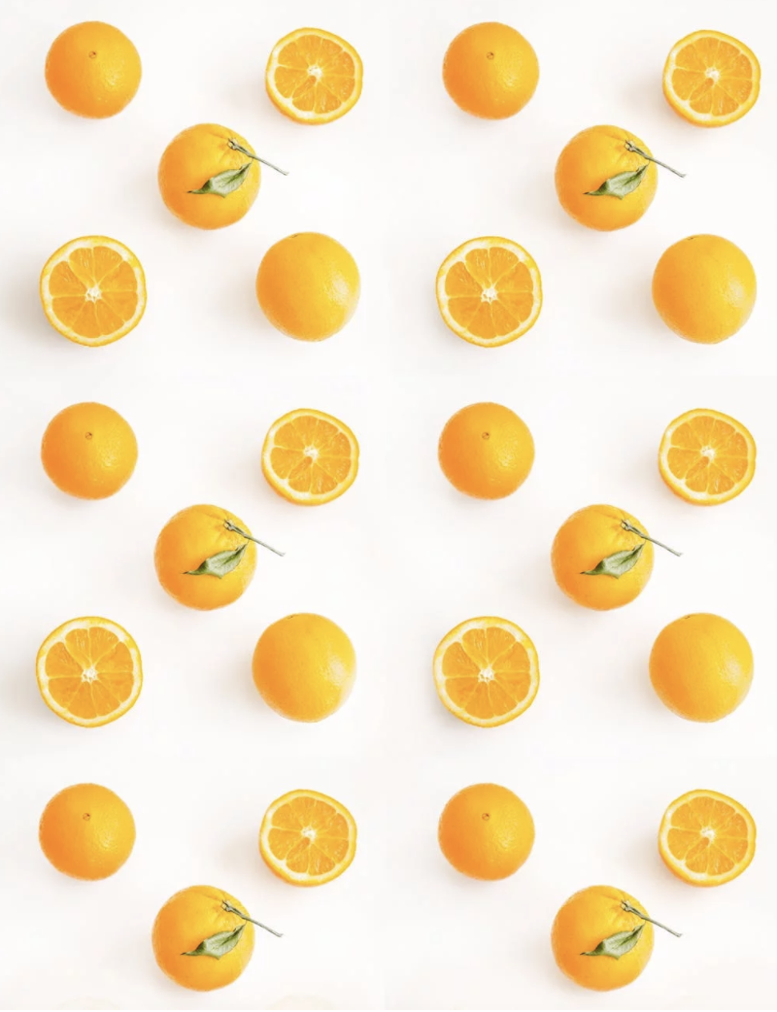


Talking Math
Day 2
Launch
How many do you see?
How do you see them?
Grade 5 | Generally, there is between and cup of juice in one orange. About how much juice would half an orange produce? How much juice could all of the oranges in the picture produce?
Notes:
Link to the Picture (we cropped the original image to fit within the K-1 CCSS)

Slide 4

Talking Math
Day 2
Grade K | How many do you see and how do you see them? (K.CC.A.3)
Grade 1 | How many more whole oranges are there than half oranges? (1.OA.A.1)
Grade 2 | Sketch how you could arrange the oranges in an array. (2.OA.C.4)
Grade 3 | How many whole oranges do you see? How many halves? (3.NF.A.1)
Grade 4 | How many oranges are there altogether? How many ’s? How many ‘s? (4.NF.B.3)
Grade 5 | Fun fact: Generally there is between and cup of juice in one orange. About how much juice would half an orange produce? (5.NF.B.7) How much juice could all of the oranges in the picture produce?
Notes:
After the image:
What fruits look like geometric shapes? List the fruits and the shapes they look like.
This link shows an image of a packed prism of oranges. What mathematical questions could you ask about the image?
Cubist art uses shapes to convey real life fruits. Research about this style of art and see if you can draw a pineapple in this style.
Find somewhere around you that relates to the math you saw in the image. Take a picture or shoot a video. Send it our way!
Link to the Picture (we cropped the original image to fit within the K-1 CCSS)

Slide 5
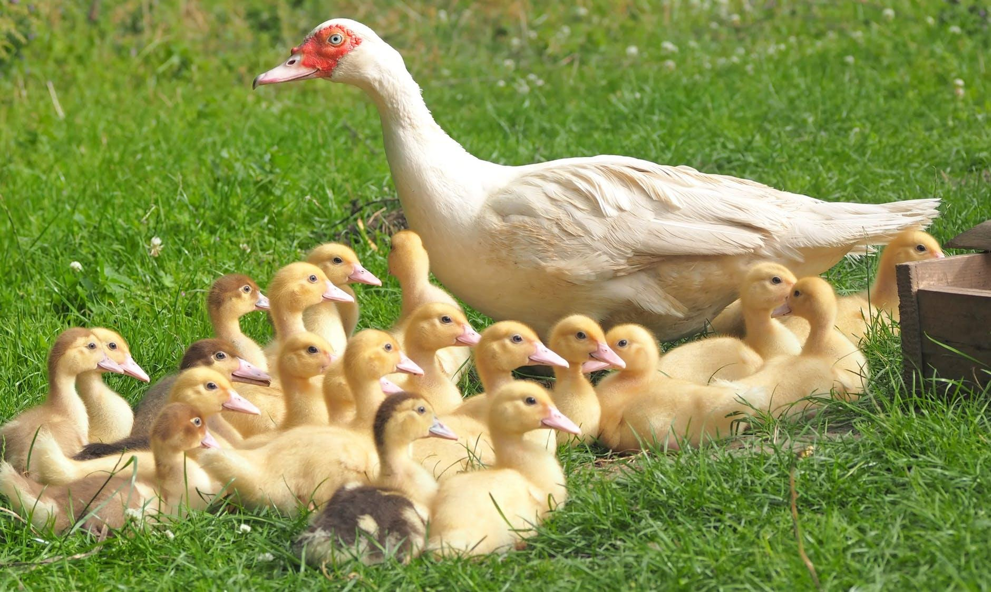
Talking Math
Day 3
Launch
What do you notice?
What do you wonder?
Grade 2 | Describe how you would count the number of duck feet in the picture.
Notes:
Link to the Picture

Slide 6
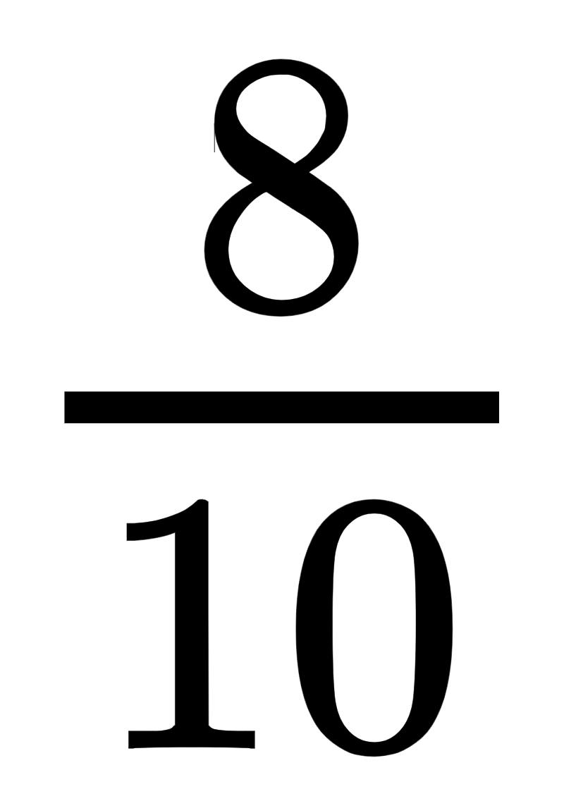
Talking Math
Day 3
Grade K | Are there more or less than 15 baby ducks? How could you find out? (K.CC.C.6)
Grade 1 | If 12 more ducks joined the group, how many would there be altogether? Explain or show how you know. (1.NBT.C.4)
Grade 2 | Describe how you would count the number of duck feet in the picture. (2.OA.C.1)
Grade 3 | The ducks sleep in straw beds that hold 3 ducks at a time. How many straw beds would be needed for the ducks in the picture? How many beds would be needed if there were 42 ducks? (3.OA.B.6)
Grade 4 | Ducks sleep about 10 hours per day. About how many hours does each duck sleep in 3 days? Explain or show how you know. (4.NF.B.3.C)
Grade 5 | When feeding baby ducks bag of feed is divided among 8 feeding bowls. How much of a feedbag will be in each bowl? Explain or show how you know. (5.NF.B.7)
Notes:
After the image:
What birds do you see around your home?
Sketch and color the different birds you see.
Keep track of the type and number of birds you see during the day. Make a display of the data. Show someone and ask them what they learn by looking at your display.
Ducks weigh far less than one might imagine. Find the weights of different kinds of ducks and put them in order from least to greatest.
Mallard ducks migrate to different places. Read more about them here. Where do Mallard ducks live?
Learn how to draw some birds with Mo Willems here.
Related children’s book: Johnny’s Pheasant by Cheryl Minnema
Find somewhere around you that relates to the math you saw in the image. Take a picture or shoot a video. Send it our way!
Link to the Picture:
https://www.pexels.com/photo/white-duck-with-22-ducklings-in-green-grass-field-160509/

Slide 7
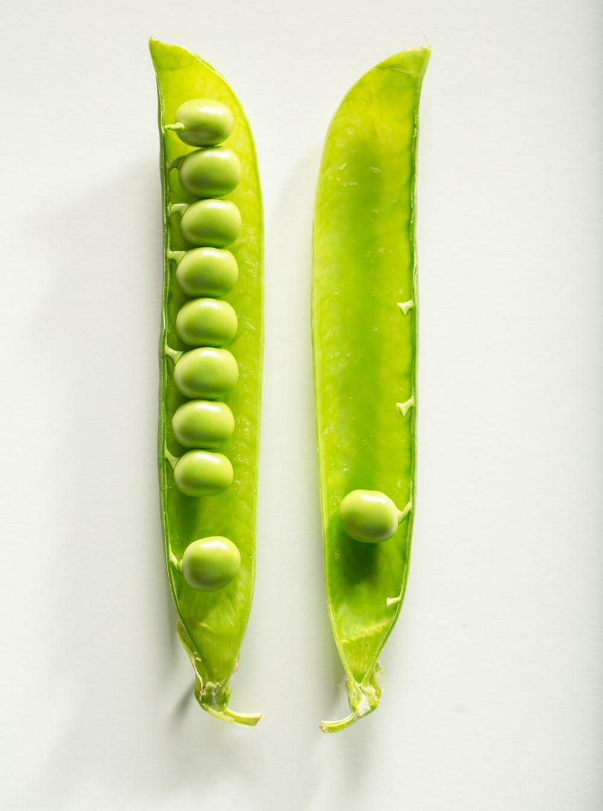
Talking Math
Day 4
Launch
What math questions do you have, could you ask, and could you answer about this picture?
Grade 3 | A serving of peas is about 9 pea pods. How many peas are in a serving?
This is one pea pod split open.
Notes:
Link to the Picture

Slide 8
Talking Math
Day 4
Grade K | How many peas are there? Draw other ways the same peas could be arranged on each side. (K.CC.A.3)
Grade 1 | After a rabbit ate some peas from this pod there were 7 peas left. How many peas did the rabbit eat? (1.OA.A.1)
Grade 2 | Is the number of peas in the pod odd or even? How do you know? (2.OA.C.3)
Grade 3 | A serving of peas is about 9 pea pods. About how many peas are in a serving? (3.NBT.A.3)
Grade 4 | Fun Fact: In 1984 Janet Harris of Sussex, UK set the world record for eating 7,175 peas. About how many pods would that be? How do you know? (4.NBT.B.6)
Grade 5 | Janet Harris (see fun fact above) ate the 7,175 peas in 1 hour. About how many peas did she eat in a minute? (5.NBT.B.6)
This is 1 pea pod split open.
Notes:
After the image:
Find pictures of other vegetables that come in groups? Do they typically come in groups of odd or even numbers?
Find other places you see arrangements of 10 things around you. Draw a picture of them and show someone!
Green peas are transported from farms in bushels that usually weigh about 28 pounds. Find out more here about the weights of different vegetables. What problems can you make up and solve about vegetable weights?
Recommended book about counting: Count on Me by Miquel Tanco
Find somewhere around you that relates to the math you saw in the image. Take a picture or shoot a video. Send it our way!
Link to the Picture

Slide 9
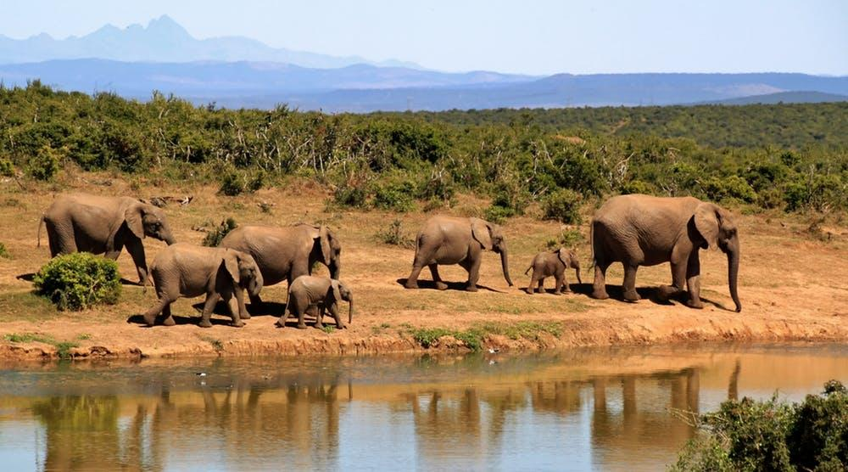
Talking Math
Day 5
Launch
Tell a story about the picture.
Grade 1 | If 8 more elephants came to the watering hole, how many elephants would there be? Explain or show how you know.
Notes:
Link to Picture

Slide 10
Talking Math
Day 5
Grade K | How many elephants are in the picture? How many more would make 10? (K.OA.A.4)
Grade 1 | If 8 more elephants came to the watering hole how many elephants would there be? (1.OA.C.6)
Grade 2 | One of the baby elephants weighs 180 pounds. Another baby elephant weighs 10 pounds less than that. How much does the other baby elephant weigh? (2.NBT.B.8)
Grade 3 | A baby elephant typically weighs about 200 pounds. What are three possible weights for an elephant whose weight would round to 200? (3.NBT.A.1)
Grade 4 | A baby elephant typically weighs about 200 pounds. An adult female elephant is about 30 times heavier than a baby elephant. List some possible weights of a female elephant? How do you know? (4.OA.A.2)
Grade 5 | An African forest elephant’s tusks grow about 17 cm each year. If an elephant lives to be 65 years old, about how long, in meters, would their tusks be? (5.NBT.B.5 and 5.MD.A.1)
Notes:
After the image:
Visit this site to find out more fun facts about elephants. What math story problems can you make up about elephants?
Try to make an origami elephant.
Recommended children’s book: There is a Bird on Your Head by Mo Willems
Link to Picture

Slide 11
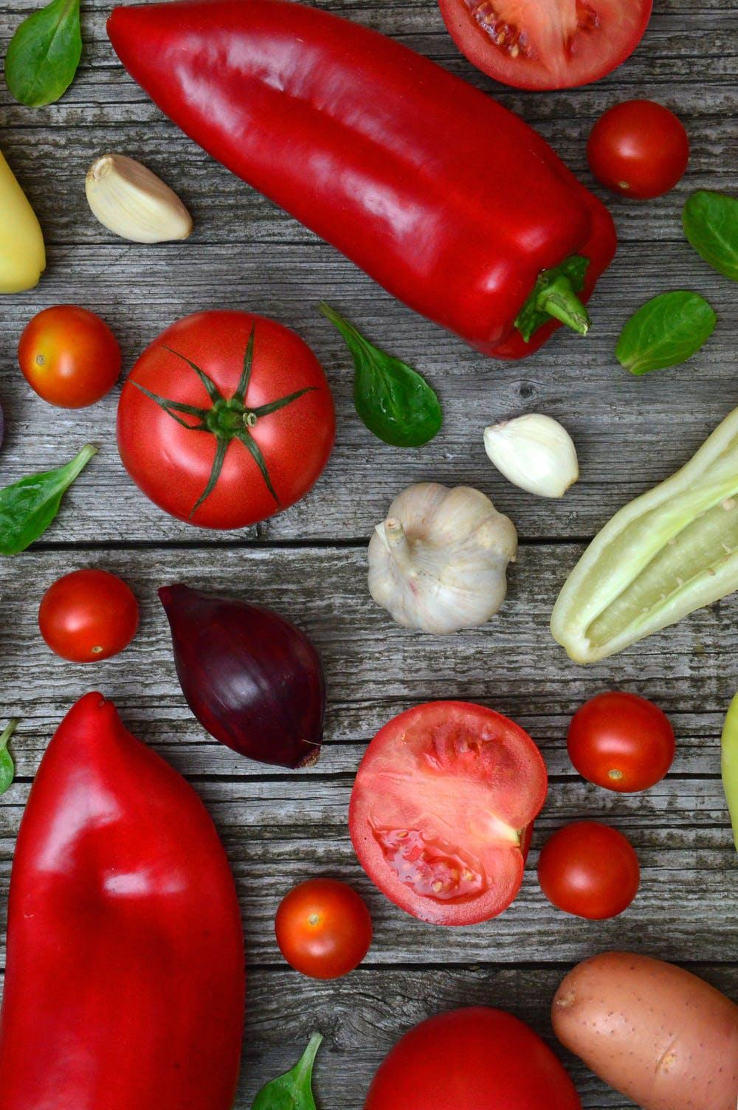

Talking Math
Day 6
Launch
Tell a story about what happened before this picture was taken.
Grade 4 | The green basil leaves are about 1 inches long. About how long would a line of 6 basil leaves be?
Notes:
Link to the Picture

Slide 12
Talking Math
Day 6
Grade K | How many red fruits and vegetables do you see? How many green leaves do you see? Are there more red vegetables or green leaves? (K.MD.B.3, K.CC.C.6)
Grade 1 | Think of 3 categories to sort the fruits and vegetables. Create a data display. Write 2 questions for someone to answer about the data in your display. (1.MD.C.4)
Grade 2 | Create a bar graph to represent the fruits and vegetables in the picture. (2.MD.D.10)
Grade 3 | The smallest tomato is about 1 inch across. How long does the red pepper look to be? (3.MD.B.4)
Grade 4 | The green basil leaves are about 1 inches long. About how long would a line of 6 leaves be? (4.MD.A.2)
Grade 5 | The weight of a tomato can vary from 14 grams all the way up to 1.8 kilograms. Find the difference, in grams, between these weights. (5.MD.A.1)
Notes:
After the image
Make a picture graph or bar graph about the fruits and vegetables in the picture.
Estimate the lengths of the fruits and vegetables and make a line plot about the data.
There are thousands of different types of tomatoes, what kind of tomatoes do your family and friends enjoy eating? Create a survey to find out.
Related children’s book: Growing Vegetable Soup by Lois Ehlert
What fruits and vegetables do you see around you? Draw a picture of your favorite and explain why it is your favorite.
Take a picture, or draw, a group of fruits and vegetables and ask someone 3 questions to answer about them.
Link to the Picture

Slide 13
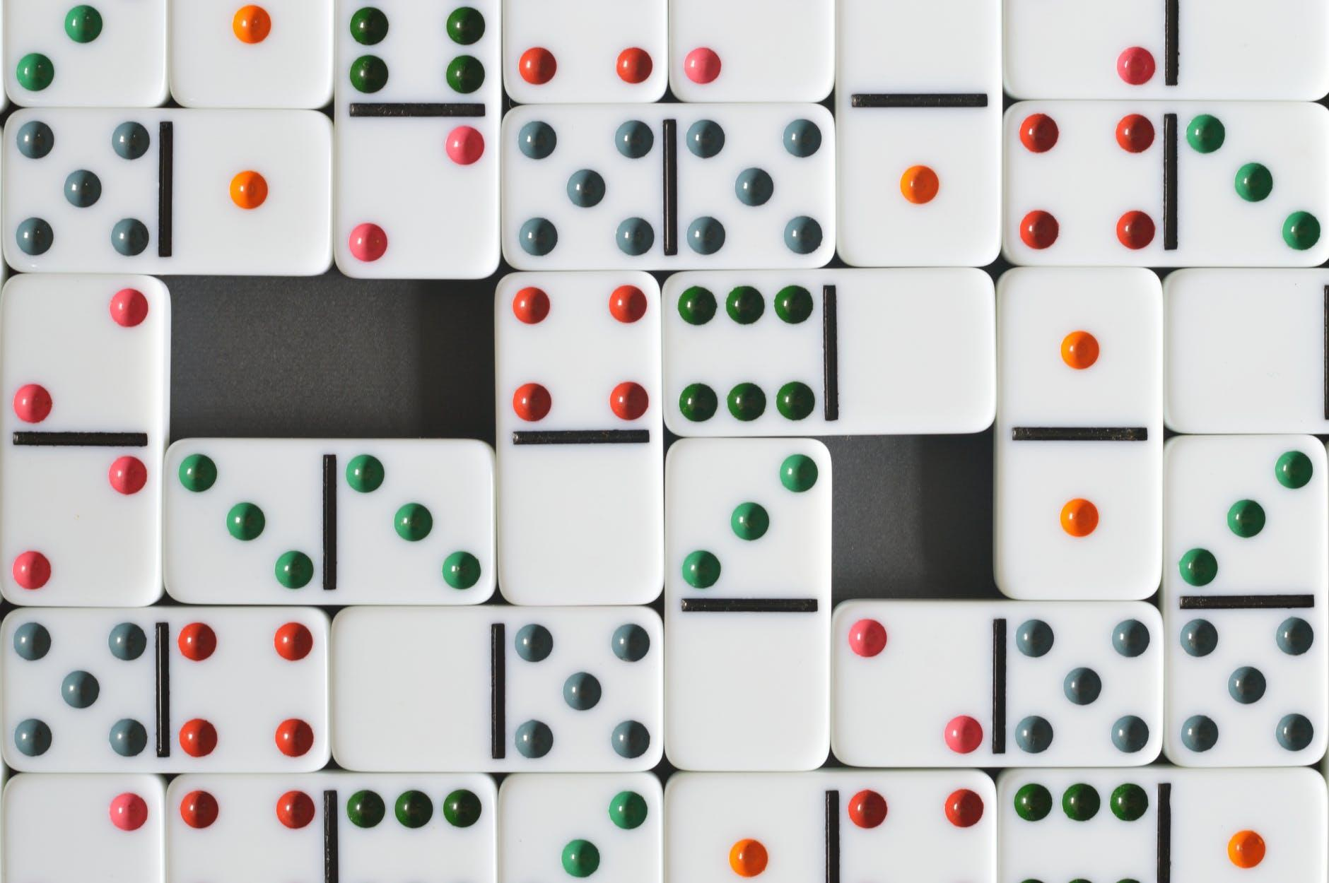
Talking Math
Day 7
Launch
What do you know about dominoes?
What questions do you have about dominoes?
Grade 1 | How many dots are on all of the dominoes in the picture?
Notes:
Link to the Picture

Slide 14
Talking Math
Day 7
Grade K | Are there more or less than 15 red dots? How do you know? (K.CC.A.3)
Grade 1 | How many dots are on all the dominoes? (1.NBT.A.1)
Grade 2 | Using the number of dots on the dominoes, can you use addition and subtraction to make 25? 50? 100? Can you make every number between 25 and 100? (2.NBT.B.5)
Grade 3 | Using the number of dots on the dominoes, can you use addition, subtraction, multiplication, or division to make 50? 100? What other numbers can you make between 1 and 100? (3.OA.C.7)
Grade 4 | Using the number of dots on the dominoes, can you use addition, subtraction, multiplication, or division to make 100? 500? What is the smallest number you can make with 5 dominoes? What is the largest number you can make with 5 dominoes? (4.NBT.B.4, 4.NBT.B.5)
Grade 5 | Each domino is about 1 ¾ inch by ⅞ inch. What is the approximate area, in square inches, of the empty space? (5.NF.B.6)
Notes:
After the image:
Roll a number cube 4 times to generate 4 numbers. Use addition, subtraction, multiplication, or division with all 4 numbers to make as many numbers as you can between 1 and 30.
Play the math game 24 online here.
Play online dominoes here.
Read more about the history of dominoes here.
Link to the Picture

Slide 15

Talking Math
Day 8
Launch
What is another word you can spell with the letters shown?
Grade 2 | Use the digits on the tiles to create 2 numbers with a sum or difference close to 100.
Notes:
Link to the Picture

Slide 16
Talking Math
Day 8
Grade K | The “M” tile has the number 3 on it. Can you start counting at 3 and count up to 42? (K.CC.A.2)
Grade 1 | There are about 46 tiles in the picture. Can you start counting at 46 and count up to 120? (1.NBT.A.1)
Grade 2 | Use the digits on the tiles to create 2 numbers with a sum or difference close to 100. (2.NBT.B.5)
Grade 3 | The “M” tile is worth 3 points. How many 3’s are in 18? How many 3’s are there in 24? (3.OA.B)
Grade 4 | Using all of the digits on the tiles, what is the greatest number you can make? Write the number in expanded form. (4.NBT.A.2)
Grade 5 | Use all of the digits on the tiles and decimal points to create 2 numbers with a sum or difference close to 2.55. (5.NBT.B.7)
Notes:
After the image:
List as many words as you can with the letters on the tiles. How many points is each word worth?
In word games the letters are given point values based on how commonly they are used in words. For example an “A” is worth 1 point and a “Z” is worth 10 points. Think of the letters in the alphabet and decide what values, between 1 and 10, each letter could have. You can check your answers here.
What word games do you like to play? What are some of the different ways that math is used in the word games you know?
Find somewhere around you that relates to the math you saw in the image. Take a picture or shoot a video. Send it our way!
Link to the Picture

Slide 17
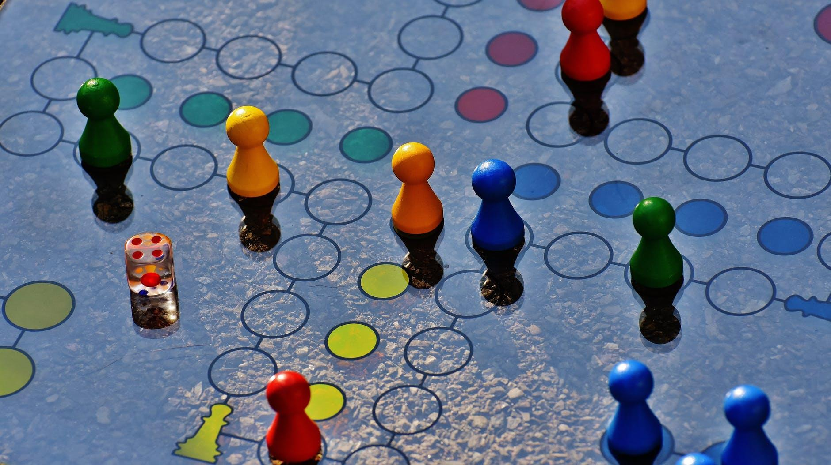
Talking Math
Day 9
Launch
What do you notice?
What do you wonder?
Grade 4 | The full game board is a square with an area greater than 100 square inches, but less than 300 square inches. What could be the length of each side of the game board?
Notes:
Link to the Picture

Slide 18
Talking Math
Day 9
Grade K | How could you sort the game pieces? (K.MD.B.3)
Grade 1 | If you used the game pieces to measure the length of your hand, how many do you think it would take? Why? (1.MD.A.2)
Grade 2 | Each game piece in the picture is about 1 inch long. If we laid them end to end in a straight line, would the line be longer or shorter than 1 foot? (2.MD.A.3)
Grade 3 | Diego played this game from 1:10 PM until 3:05 PM. How long did Diego play the game? (3.MD.A.1)
Grade 4 | The full game board is a square with an area greater than 100 square inches, but less than 300 square inches. What could be the length of each side of the game board? (4.MD.A.3)
Grade 5 | This game comes in a box with dimensions of 2 inches by 7 inches by 15 inches. What is the volume of the game box? (5.MD.C.5)
Notes:
After the image:
Make up a game to play at home with your family. What will you call the game? What will you use for game pieces? Can you create a game board? Consider using dice or cards to make moves. Once you decide the rules of your game, play the game with your family.
When you play games at home, use a data display to record the number of games each player wins.
What are some games that involve mathematics? Send us the names of your favorites!
Recommended reading with a task.
Link to the Picture

Slide 19
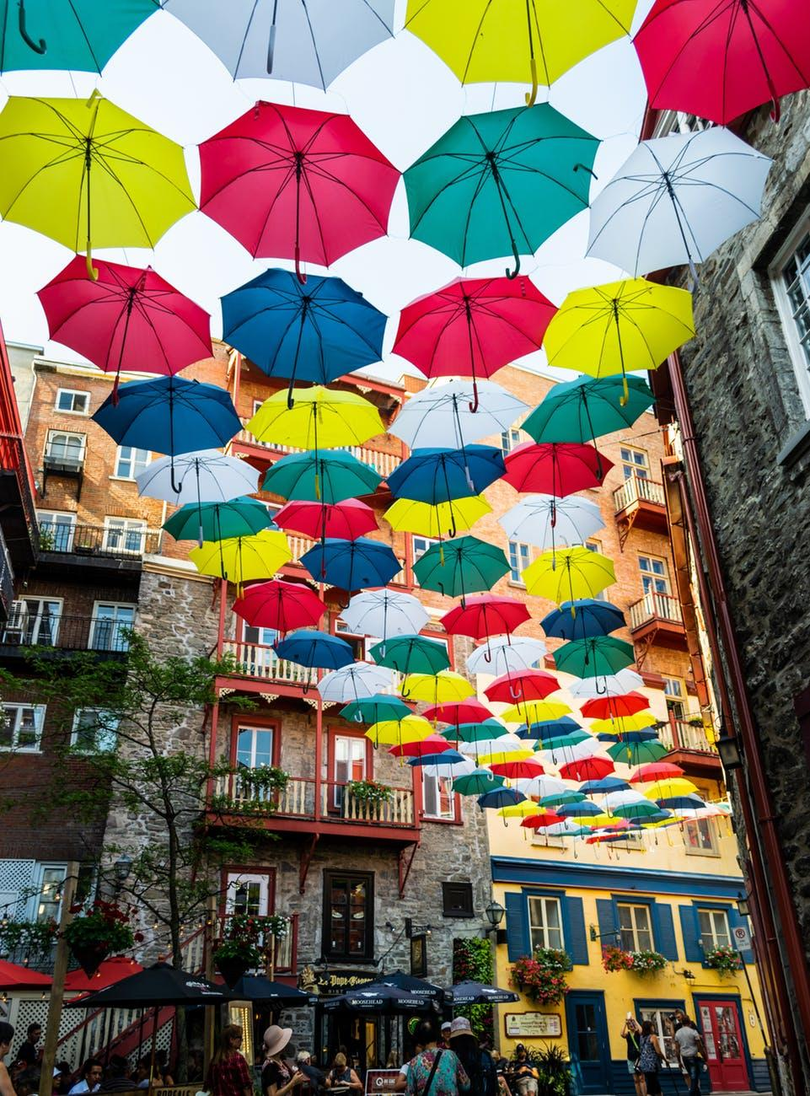
Talking Math
Day 10
Launch
What math questions could you ask about this picture?
Grade 3 | If there are 18 rows of umbrellas, how many umbrellas are there altogether?
Notes:
Link to the Picture

Slide 20
Talking Math
Day 10
Grade K | How many red umbrellas do you see? How many green umbrellas do you see? (K.CC.B.5)
Grade 1 | How many white and blue umbrellas do you see? Show or explain your reasoning. (1.NBT.C.4)
Grade 2 | Is the number of umbrellas in 3 rows odd or even? Explain your thinking. (2.OA.C.3)
Grade 3 | If there are 18 rows of umbrellas, how many umbrellas are there altogether? (3.OA.A.3)
Grade 4 | Elena wants to copy this umbrella pattern for a party. She bought 128 umbrellas to hang in this pattern. How many rows of umbrellas will she have at her party? (4.NBT.B.6)
Grade 5 | There are 10 streets that have this umbrella pattern. If there are 18 rows of umbrellas on each street, how many umbrellas are there altogether? What if there were 100 streets? 1,000 streets? What patterns do you notice in the number of umbrellas? (5.NBT.A.2)
Notes:
After the image:
Multiplication Matching Game
Make an array pattern with some objects at home. ( Suggestions: coins, buttons, spoons) How many different ways can you arrange the objects?
What kind of angles do you see in the picture? How does an umbrella connect to what you know about circles and angles?
Learn more about umbrellas here. What mathematical questions can you ask about the history of umbrellas? What geometry questions can you ask about the shape of an umbrella?
There are many amazing images of umbrellas out there. Find an image of umbrellas and write your own math questions about them.
Link to the Picture

Slide 21
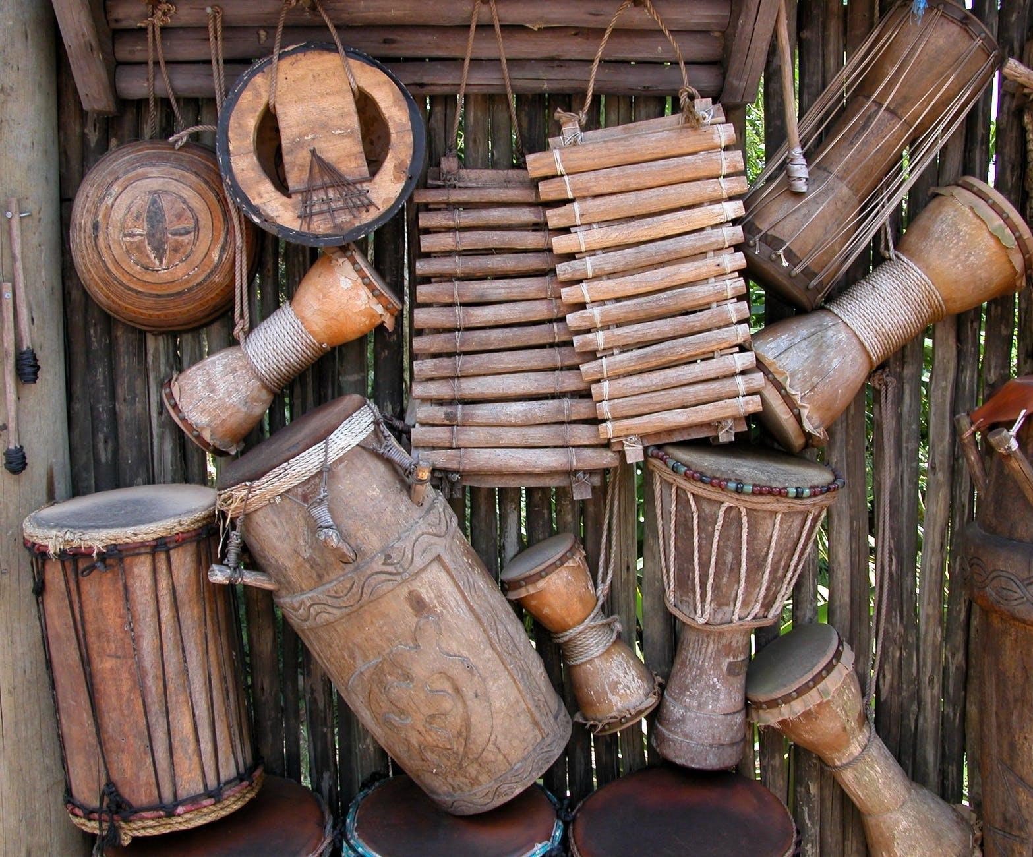
Talking Math
Day 11
Launch
What does this picture remind you of?
Grade 5 | The world record for most drum beats in one minute is 2,109 beats. How many beats in one second is that?
Notes:
Link to the Image

Slide 22
Talking Math
Day 11
Grade K | How many instruments do you see? How did you count? Can you write that number? (K.CC.B.5)
Grade 1 | Priya has some instruments like these. She has 8 drums, 6 xylophones, and 4 shakers. How many instruments does Priya have altogether? Explain or show your reasoning. (1.OA.A.2)
Grade 2 | The world’s largest drum set has 340 pieces. What number is 100 more than 340? What number is 10 less than 340? (2.NBT.B.8)
Grade 3 | The world’s largest drum set has 340 pieces. What are two numbers that add to 340? What are two numbers that have a difference of 340? (3.NBT.A.2)
Grade 4 | The world record for most drum beats per minute is 2,109 beats. How many beats would that be in 3 minutes? (4.NBT.B.4)
Grade 5 | The world record for most drum beats in one minute is 2,109 beats. How many beats in one second is that? (5.NBT.B.6)
Notes:
After the image:
Read more fascinating facts about drums here.
Learn about an xylophone here.
Sketch a plan for an instrument you can make using things around you. List your materials. Make the instrument if you can.
Measure the different lengths of the instruments with a ruler. What unit did you use? Display your data.
Find something around you that relates to the math you saw in the image. Take a picture or shoot a video. Send it our way!
Link to the Image

Slide 23
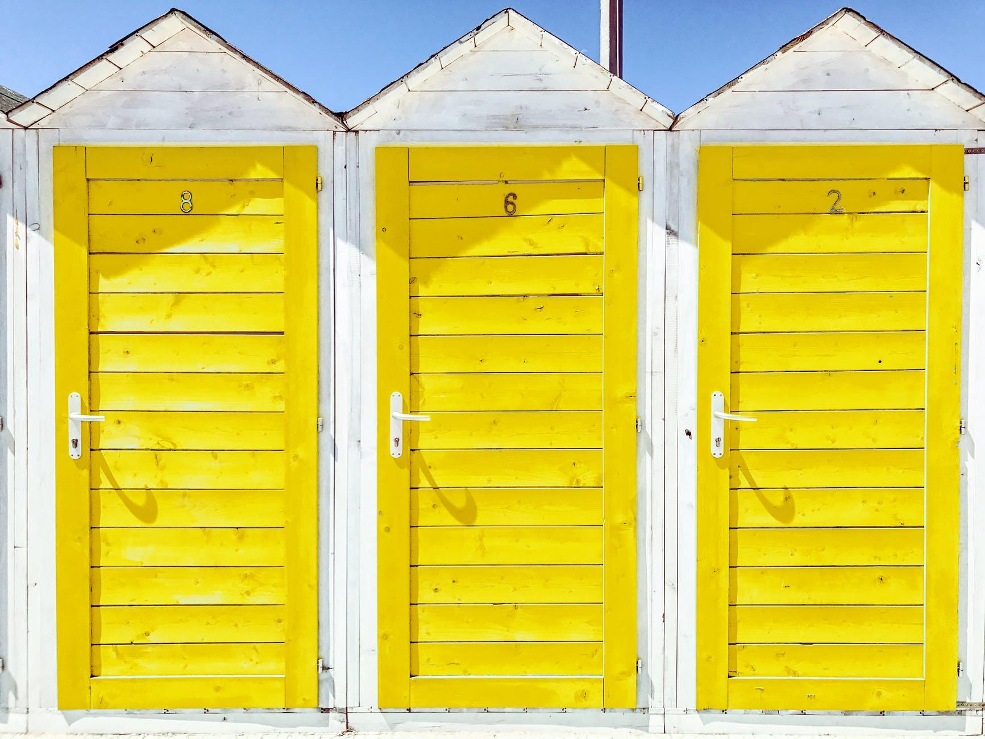
Talking Math
Day 12
Launch
Where do you see math in the picture?
Grade 2 | Where would you draw a line to show a third of a door? Can you show a third of the door in a different way?
Notes:
Link to the image

Slide 24
Talking Math
Day 12
Grade K | Point to objects in the picture that complete these sentences: _________ is next to _________. _________ is above __________. _________ is below __________. (K.G.A.1)
Grade 1 | Where would you draw a line to show half of each door? Can you show half of the door in a different way? (1.G.A.3)
Grade 2 | Where would you draw a line to show a third of a door? Can you show a third of the door in a different way? (2.G.A.3)
Grade 3 | If each yellow door is 8 ft high and 3 ft wide, what is the yellow painted area of each door? What is the area of all 3 doors together? (3.MD.C.7)
Grade 4 | Can you Identify the following in the picture: line segments, angles (right, acute, obtuse), and perpendicular and parallel lines? (4.G.A.1)
Grade 5 | If the board with an 8 on it is about a half foot wide and 2 ft long, what is the area of the inside section of each door? What is the area of all 3 inside door sections? (5.NF.B.6)
Notes:
After the image:
Describe the different doors you see around you, inside and outside. Which door are your favorite and why?
If you were to build a new door, where would you put it and what would you build it with?
If you could decorate a door to match your favorite book, what would you put on the door and why?
Related picture book: Door by Ji-Hyeon Lee
Find something around you that relates to the math you saw in the image. Take a picture or shoot a video. Send it our way!
Link to the image

Slide 25
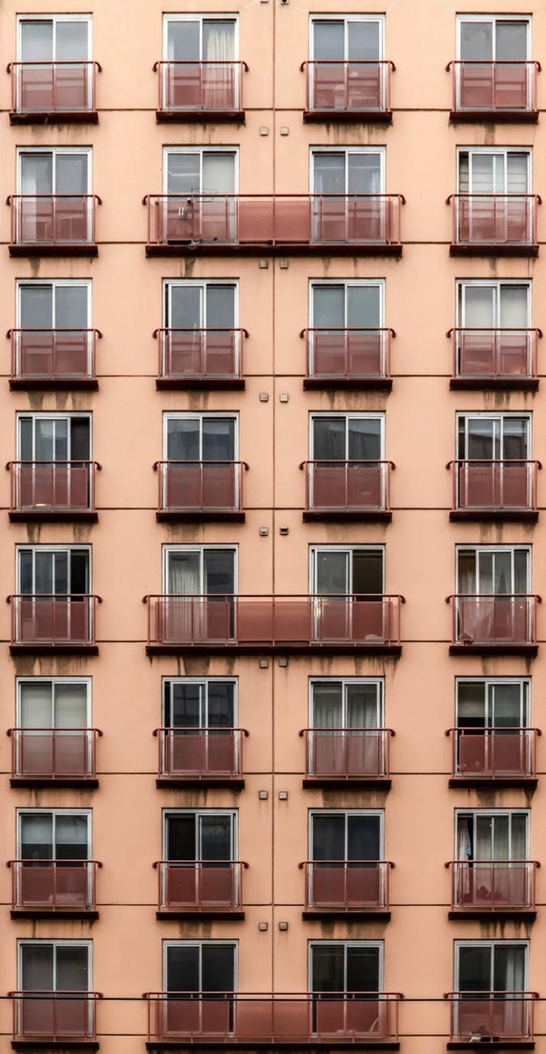
Talking Math
Day 13
Launch
What patterns do you notice in the picture?
Grade 1 | How many porches do you see in the picture? Write that number. Start at that number and count to 101.
Notes:
Link to the image

Slide 26
Talking Math
Day 13
Grade K | How many glass doors do you see in the top two rows? (K.CC.B.5)
Grade 1 | How many porches do you see in the picture? Write that number. Start at that number and count to 101. (1.NBT.A.1)
Grade 2 | How many glass doors do you see in the top 5 rows? Write an equation to match the array in the top 5 rows. (2.OA.C.4)
Grade 3 | Write a multiplication equation to represent the number of glass doors in the picture. (3.OA.A.1)
Grade 4 | Each pane of glass in a door is 4 times as tall as it is wide. If the pane of glass is 34 inches wide, how tall, in inches, is it? (4.OA.A.2)
Grade 5 | The length of the smaller porch is 72 inches and the width is 36 inches . Find the area, in square inches, of the smaller porch. What do you think the area might be of the larger porch? Why? (5.NBT.B.5)
Notes:
After the image:
Look for and sketch arrays you see in your home or in your neighborhood.
Grade 3: Try out this task about multiplication!
What other things can you count in this image? How would you count them? How many of them are there?
Draw a picture of another type of building you have seen that looks the same or different than this one.
Link to the image

Slide 27
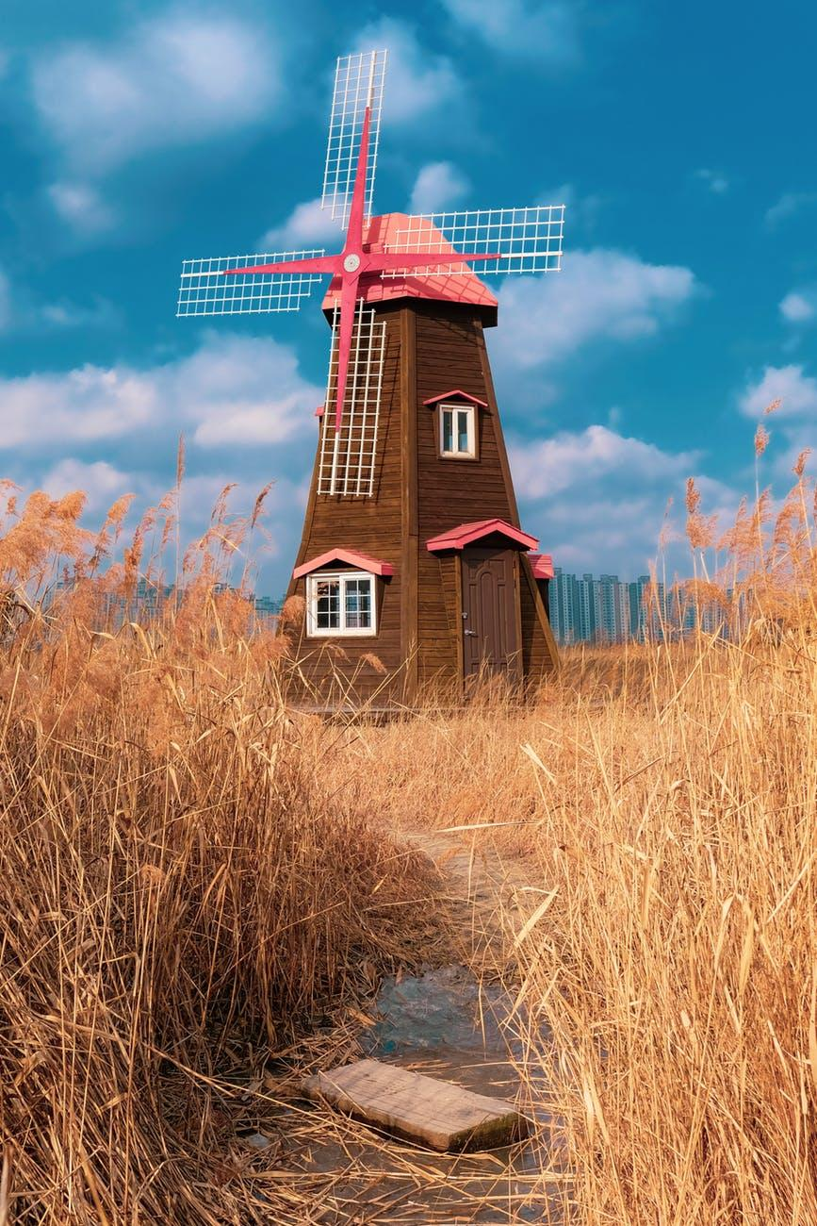
Talking Math
Day 14
Launch
Describe what you think you might see if you walked inside the windmill.
Grade 5 | Name the different types of quadrilaterals in the picture. How are they the same? How are they different?
Notes:
Link to the image

Slide 28
Talking Math
Day 14
Grade K | What shapes do you see? Can you draw or build the shapes you see? (K.G.A.2, K.G.B.5)
Grade 1 | What shapes do you see? What smaller shapes make up the larger shapes? (1.G.A.2)
Grade 2 | How many rectangles do you see? Where do you see a rectangle broken into smaller squares? (2.G.A.1, 2)
Grade 3 | Where do you see 4-sided shapes in the picture? What are the names of the 4-sided shapes you see? (3.G.A.1)
Grade 4 | Where do you see parallel and perpendicular lines? Where do you see acute, obtuse, and right angles? (4.G.A.1)
Grade 5 | Name the different types of quadrilaterals in the picture. How are they the same? How are they different? (5.G.B.3)
Notes:
After the image:
Make a model of a windmill with things you have around you.
Windmills have been used for hundreds of years. Read more about their history here.
Windmills have been used in countries all over the world. Sketch a map of the world and use a symbol to show the locations of windmills in history.
Link to the image

Slide 29
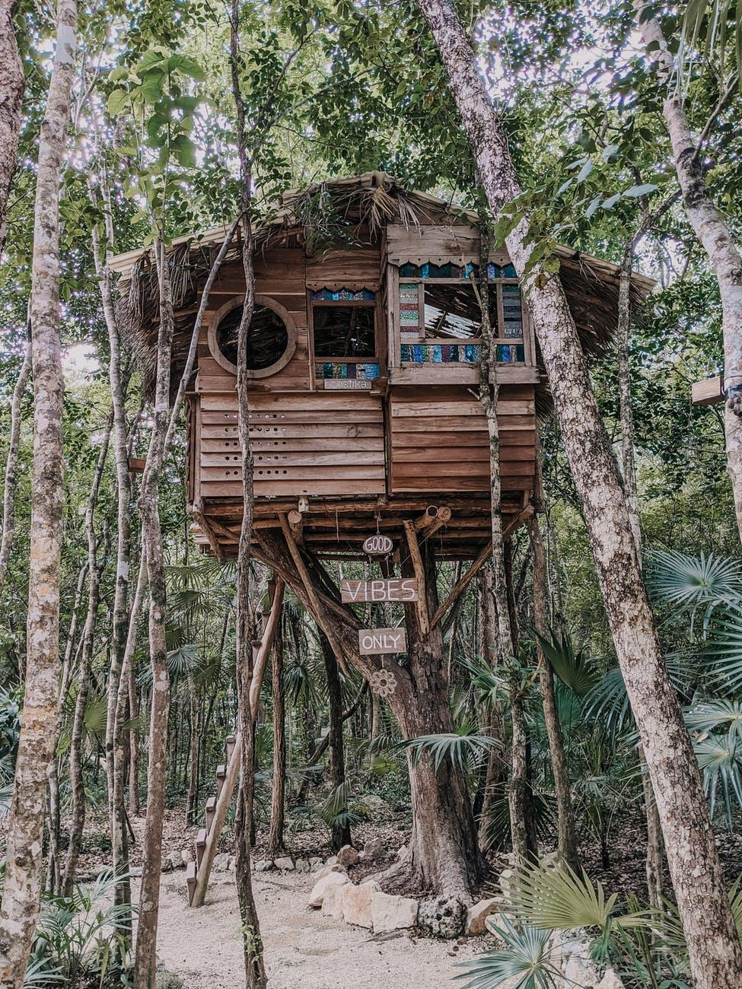
Talking Math
Day 15
Launch
What do you notice?
What do you wonder?
Grade 3 | Where do you see arrays in the picture? Write a multiplication equation to match each array you see.
Notes:
Link to the image

Slide 30
Talking Math
Day 15
Grade K | How many signs do you see hanging on the treehouse? How many windows do you see in the treehouse? Write the numbers. (K.CC.A.3)
Grade 1 | There are at least 68 different pieces of glass in the treehouse windows. How many tens are in 68? What is 10 more than 68? What is 10 less than 68? Draw a picture to represent the number 68. (1.NBT.B.2, 1.NBT.C.5)
Grade 2 | Where do you see arrays in the picture? Describe them using the words row and column. (2.OA.C.4)
Grade 3 | Where do you see arrays in the picture? Write a multiplication equation to match each array you see. (3.OA.A.3)
Grade 4 | A typical treehouse floor has an area of 80 square feet. What are the possible lengths and widths of a typical treehouse floor? Do you think this treehouse is more or less than 80 square feet? Why? (4.OA.B.4)
Grade 5 | A small treehouse kit costs $777. It can create a 70 square foot treehouse. How much does each square foot of the treehouse cost? (5.NBT.B.6)
Notes:
After the image:
Make your own signs for a treehouse. What will they say?
Create a tree-house design. Make a floor plan of the treehouse. Determine what materials and tools you would need to build it.
Search for images of treehouses. Which one is your favorite and why?
Write a story about life in a treehouse.
Link to the image

